Slide 1
Web Programming

Slide 2
Name : Engy Ali Yaakoub
Section : 2
Department : IS
GPA:2.6

Slide 3
The Doctor
Description : Searching for the suitable spechialized doctor .

Slide 4
Functions :
The patient chooses the spechialization at the medical field that befits his illness and the city .
The web site will show the spechialized doctors name and their addresses .
The web site will show the spechialized doctors phone numbers .
The web site will show the spechialized doctors oppointments .

Slide 5
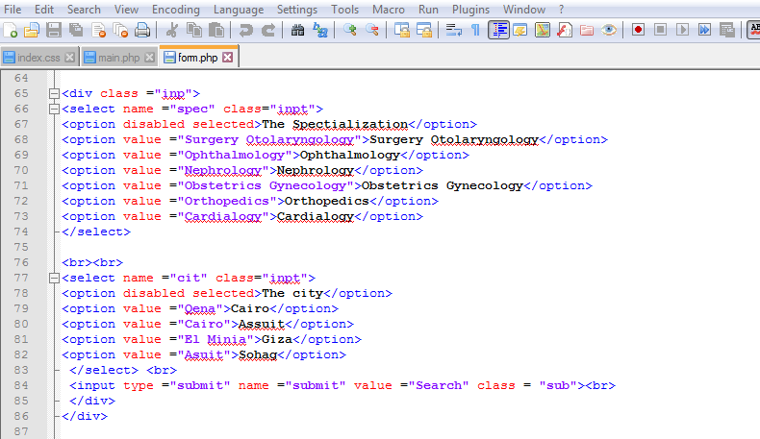
Sub codes:
At that code I use HTMLL language .

Slide 6
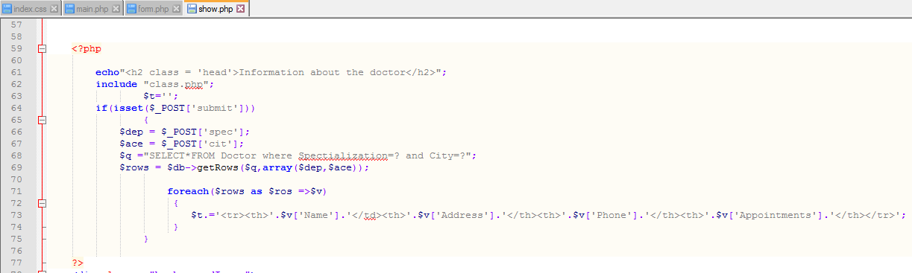
Sub codes:
At that code I use PHP language .

Slide 7
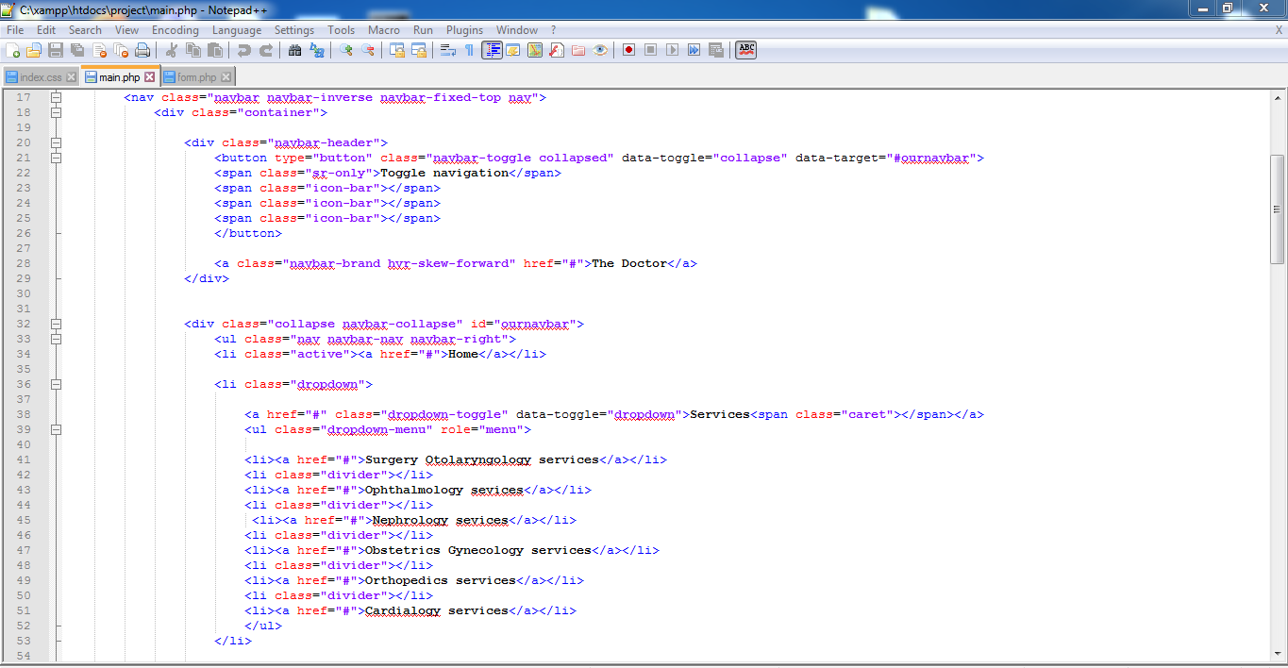
Sub codes:
At that code I use bootstrap language .

Slide 8
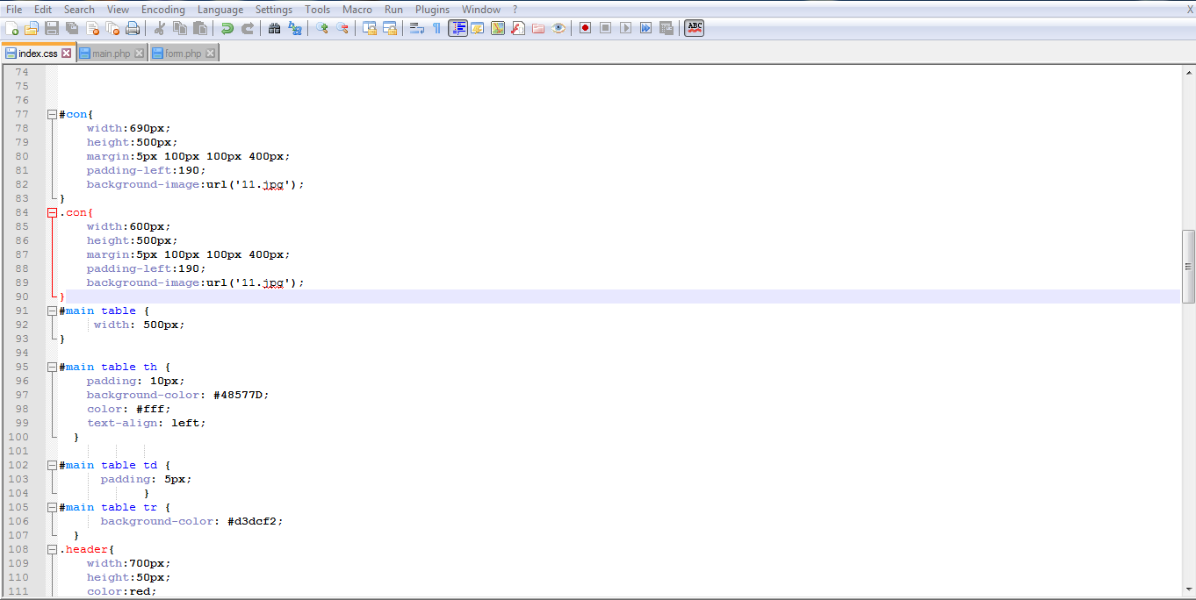
Sub codes:
At that code I use CSS language .

Slide 9
Technologies :
HTML
CSS
Javascript
PHP Mysql

Slide 10
Clients
The patients .

